Slide 1


February 26th 2015

Slide 2
OBJECTIVES
Review the modern day multi-modality approach to the wound care patient
Identify appropriate indications for hyperbaric oxygen therapy and the etiology of chronic wounds
Understand the role of the outpatients wound care center in the community and impact of chronic wounds on the healthcare system
Educate Individuals on When to Call the Wound Care Center for services

Slide 3
HISTORY OF WOUND CARE
“The class of wound and it’s shape are also important. For a contused wound is worse than one simply incised, hence it is better to be wounded by a sharp weapon than by a blunt one. Again, both age and constitution have some influence; for a boy heals more readily than an old man; on who is stronger than a weak man; a man who is not too thin or too fat than one who is either of these; one who takes exercise than a sluggard; on who is sober and temperate than one addicted to wine and venery.”
A. Cornelius Celsus, Book V, De Medicina
- Early 1st Century AD

Slide 4
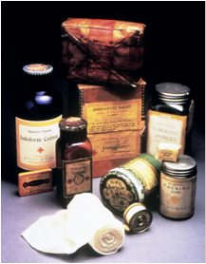
HISTORY OF WOUND CARE
1800’s:
  Dr. Joseph Lister (1827-1912) demonstrated the advantage of antisepsis in surgery using carbolic acid soaked bandages
  Pierra Joseph Desault (1744-1795) is credited with the modern concept of debridement (fr. debrider: to unbridle)

Slide 5
HISTORY OF WOUND CARE
1900’s to Present:
  Winter & Malbach (1960) tested the efficacy of wet polymer dressings
1990’s:
  Expansion of wound care polymers & dressings; including growth factors, synthetic skin equivalents, Negative Pressure Wound Therapy, Hyperbaric Oxygen Therapy, & nanotechnology

Slide 6
NATIONAL COST for Wound Care
The incidence of chronic wounds in America is equal to that of hospitalization from heart disease
Chronic wound care costs Americans an estimated 25 billion dollars each year
  Which represents 5% of the total annual spending on both Medicare & Medicaid combined

Slide 7
Who’s Effected by Wounds
Over 6.5 million Americans are estimated to have chronic wound
Over 500,000 develop annually
60,000 die annually due to pressure ulcer complications
100,000 Lower limb amputations performed on diabetics annually
185,000 Lower limb amputations performed annually in the United States

Slide 8
NATIONAL NEED For Wound Care Centers- Diabetes
Total Prevalence of Diabetes & Pre-Diabetes
  Total: 25.8 million children & adults - 8.3% of the population!
  Diagnosed: 18.8 million people
  UnDiagnosed: 7.0 million people
  Pre-Diabetes: 79 million people
  1.9 million new cases of diabetes were diagnosed in people aged 20 years or older in 2013
    http://professional.diabetes.org/admin/UserFiles/0%20-%20Sean/FastFacts%20March%202013.pdf

Slide 9
Diabetes Continued
Age 65 Years or Older: 10.9 million or 26.9% of all people in this age group, have diabetes.
60%-70% of people with diabetes have mild to severe forms of neuropathy.
Diabetic Foot Ulcer Comprise 33% of direct health care cost associated with Diabetes total $38 Billion Annually.

Slide 10
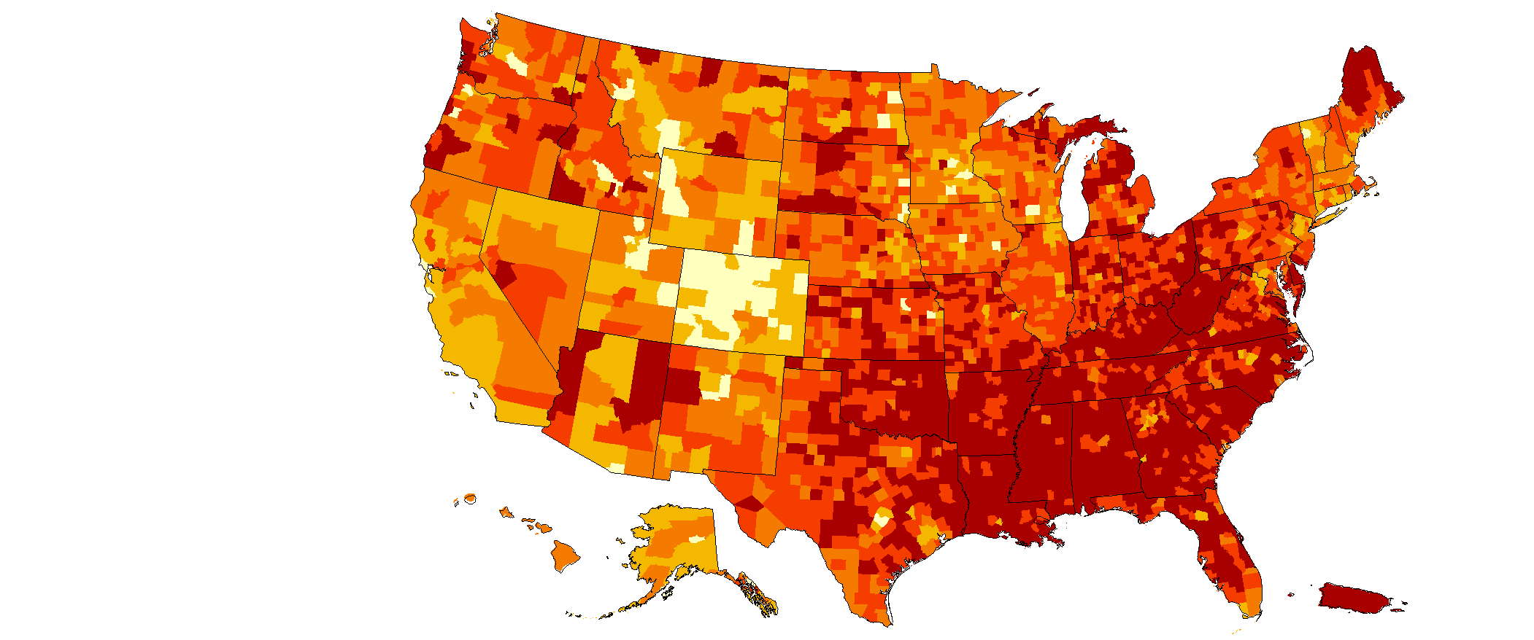
County-level Estimates of Diagnosed Diabetes among Adults aged ≥ 20 years: United States 2010
Percent
www.cdc.gov/diabetes

Slide 11
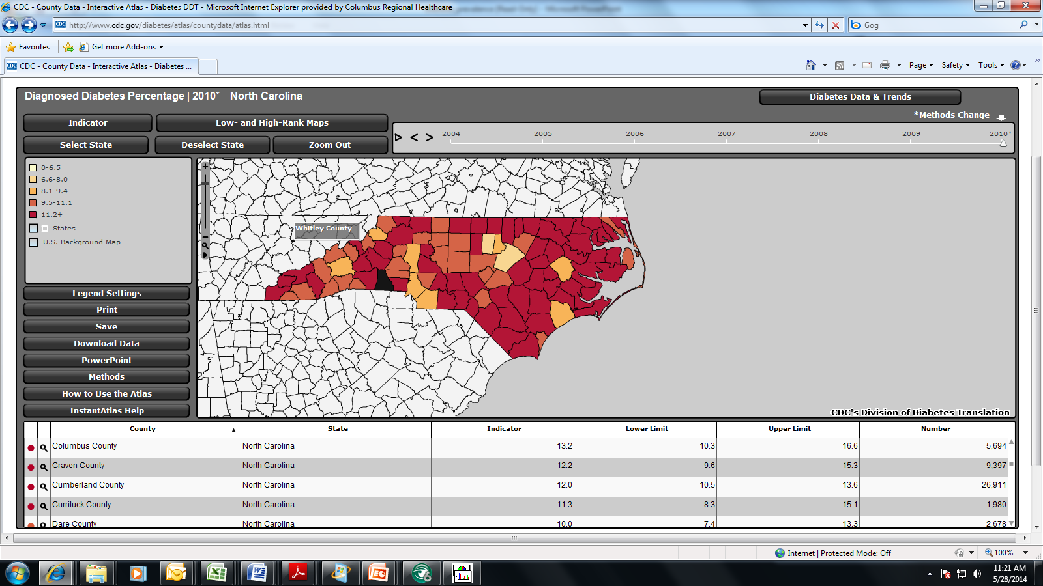
North Carolina Diabetic Population

Slide 12
Amputations
Average Cost of Amputation in 2009 $45,000
Lifetime Healthcare Cost for a Amputee $500,000
Lifetime Healthcare Cost for a Non-Amputee $250,000
More than 60% of non-traumatic lower-limb amputations occur in the people with diabetes.
Five Year Survival Rate for Diabetics following amputation 49%
Approximately 85% of diabetes‐related
amputations are preceded by a foot ulcer.

Slide 13
WHAT’S IN THE CLOSET?
Traditional Approach
Wet-to-Dry gauze
Hydrogels
Hydrocolloids
Alginates
Collagen
Antimicrobials
Advanced Approach
Negative Pressure Wound Therapy
Growth factors
Skin substitutes
Total Contact Cast
Hyperbaric Oxygen Therapy

Slide 14
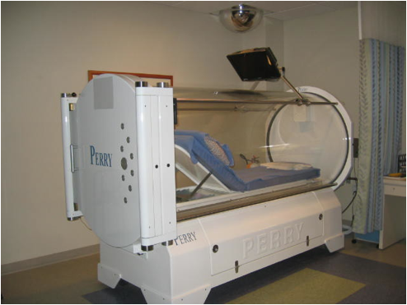
HYPERBARIC OXYGEN THERAPY

Slide 15
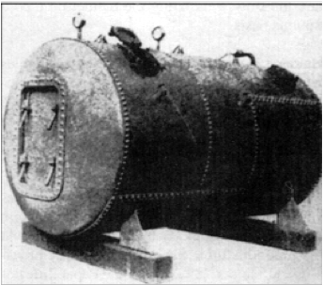
HYPERBARIC MEDICINE
One of the first successful uses of a decompression chamber was in 1879
The use of this chamber markedly reduced the number of serious cases & fatalities caused by the bends

Slide 16
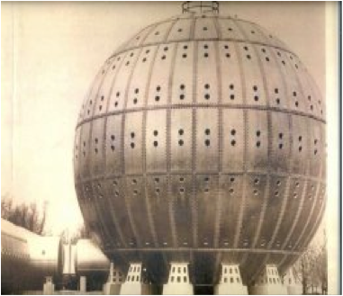
HYPERBARIC MEDICINE
The Steel Ball Hospital:
  Built for Dr. Cunningham in 1928
  Six stories high, 72 rooms with 12 bedrooms per floor
  Length of hyperbaric exposure was 4 days at 2ata

Slide 17
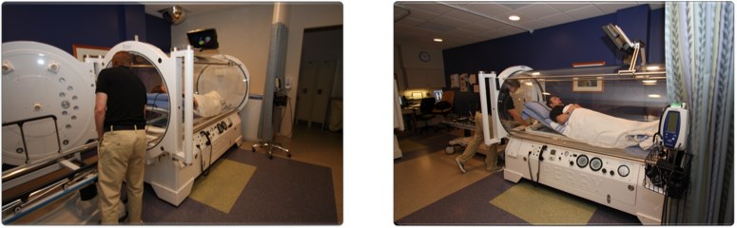
MONO-PLACE CHAMBER

Slide 18
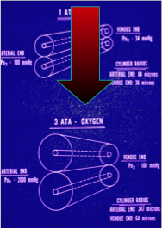
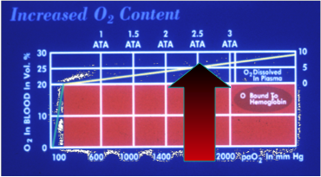
HYPERBARIC MEDICINE
Two basic effects of increased oxygen partial pressure:
  Increased dissolved oxygen content
  Increased diffusion distance for oxygen

Slide 19
INDICATIONS FOR HBO
CMS Approved 2012
Gas gangrene
Acute traumatic peripheral ischemia
Crush injury, suturing severed limbs
Progressive necrotizing infections
Acute peripheral arterial insufficiency
Preparation & preservation of compromised grafts & flaps
Chronic refractory ostemyelitis- Bone Infection
Osteoradionecrosis- Associated with Head and Neck Radiation
Soft tissue radionecrosis- Late Effect of Radiation Treatment
Diabetic Lower Extremity Wound
  Wagner Grade III or above

Slide 20
Wound Healing Center-CRHS 2014
Outcomes
  92% of all Wounds Healed YTD compared to 80% National Average
  Average Days to Healing 41 compared to 63 for the National Average
  Treatment of 500 Wounds
  3,000 Patient Visits first 12 months of Operation
  Goal: Complete wound healing in 60 days!

Slide 21
Wound Healing Center
So who can make an appointment at the Wound Healing Center
  Patients can be referred from Physician's Office, Home Health Agencies, Skilled Nursing Facilities, Community Agencies
  Patients can call the Wound Healing Center Directly
  No Physician's Referral Needed to make an appointment

Slide 22
When To call the Wound Center
If you or a loved has had a wound for 30 days with no signs of improvement call the Center.
Early intervention is the key to getting you back to living your life.

Slide 23
OUR PROGRAM
The Patient
65 yrs. Old
Diabetic
Referral
2 Ulcers on foot
Unhealed after 30 days
Meets the Team
Vascular Surgeon
General Surgeon
Trained Nurses
Advanced Treatment
Hyperbarics
Biologics
Flap Closure
Healed, Healthy
&
Back to Life!

